Slide 1
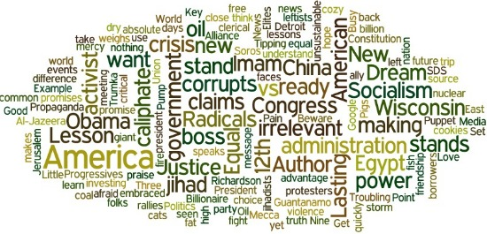


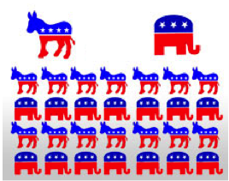

Prediction and sentiment analysis
Mahsa Elyasi

Slide 2
PAPER 1

Slide 3

Word Salad: Relating Food Prices and Descriptions V Chahuneau, K Gimpel, B.R Routledge, L Scherlis, N.A Smith

Slide 4
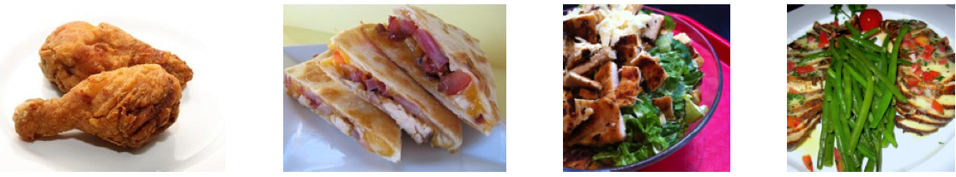
Motivation
2 pcs chicken meal
$4.99
Chicken Quesadillas
Made with fresh
Salsa, jack and
Cheddar cheese
$6.99
Caesar Salad
Romain hearts
Croutons, shaved, parmesan cheese and classic Caeser dressing
$9.95
Poulet Cajun
$28.00

Slide 5
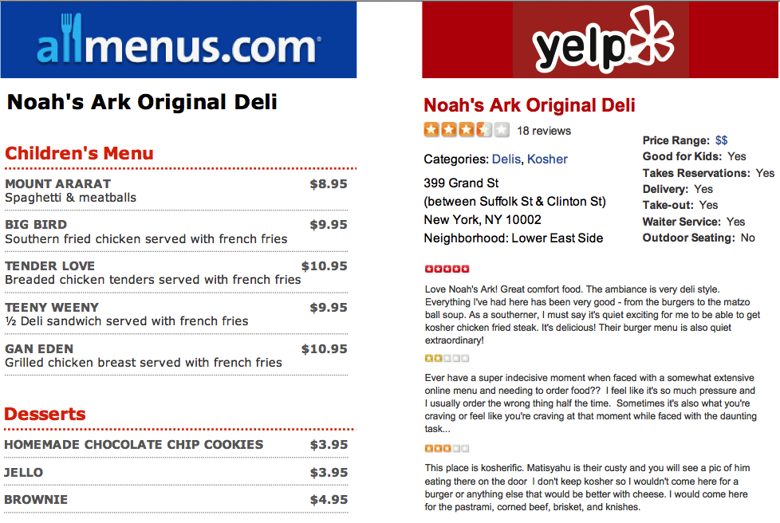
Data
7 U.S cities
location(city, neighborhood)
Services available(delivery, wifi)
Ambience(good for groups, noise level)
Price range( $ to $$$$)

Slide 6
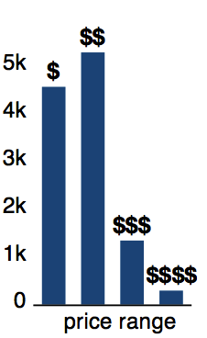
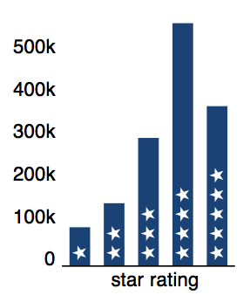
Data
Distribution of prices & stars

Slide 7
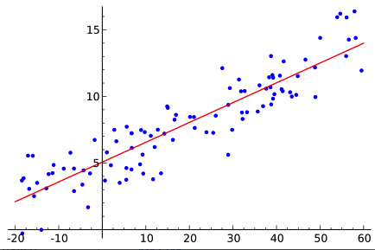
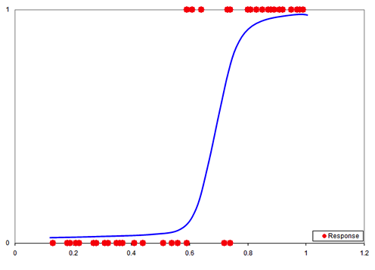
Models
Linear regression
Logistic regression
Features:
METADATA : <field, value>
MENUNAMES : n-grams
MENUDESC : n-grams
MENTION : n-grams(word + ITEM + word)

Slide 8
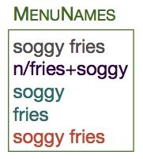
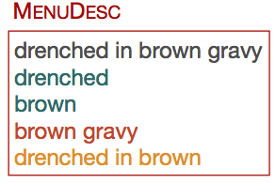
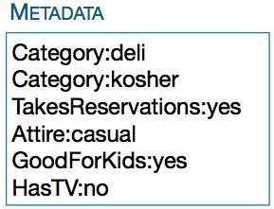
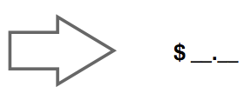
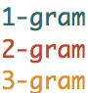
Item price prediction
Predict the price of each item on a menu

Slide 9
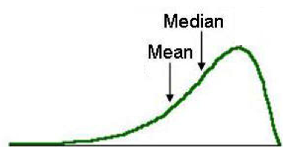
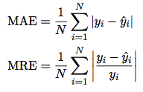
Item price prediction
Baselines
Predict mean
Predict median
Regression
Evaluation
Mean absolute error
Mean relative error
Item’s price
= w * x

Slide 10
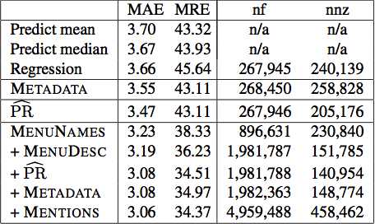
Item price prediction
Number of features with non-zero weight
$
%
Total number of features

Slide 11

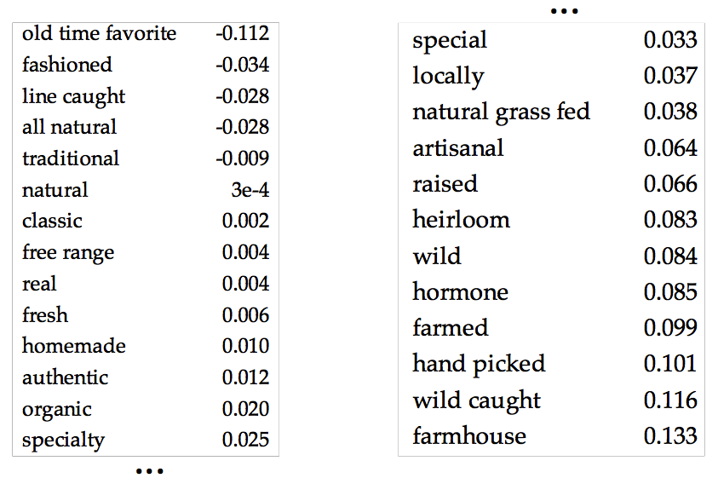
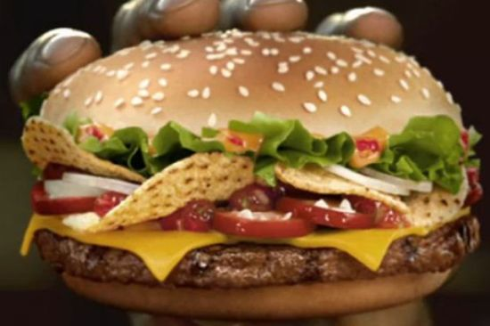
Item price prediction
MENUDESC-authenticity

Slide 12
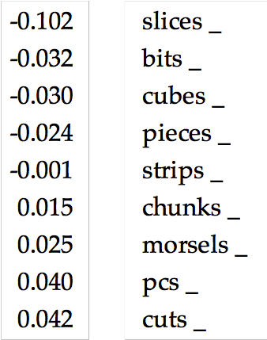
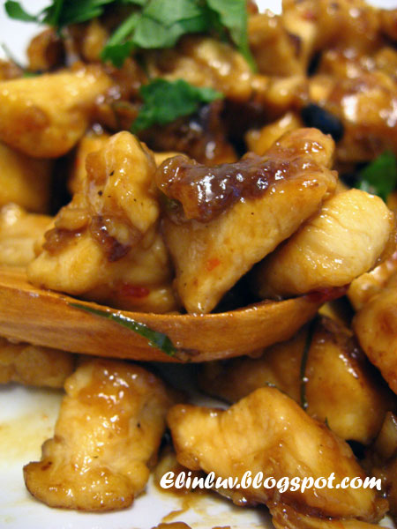
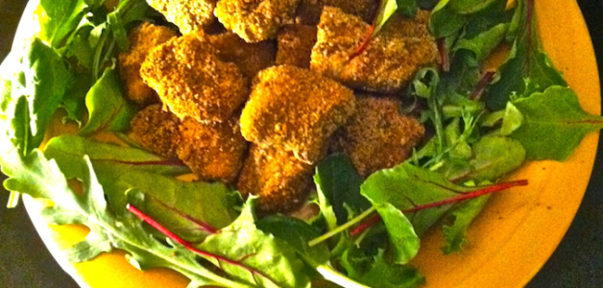

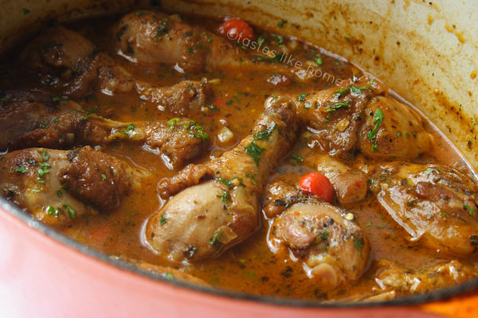
Item price prediction
MENUDESC-size

Slide 13
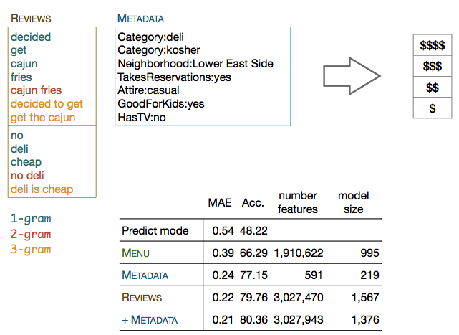
Price range prediction
For each restaurant on Yelp page
McCullagh
Ordinal regression

Slide 14
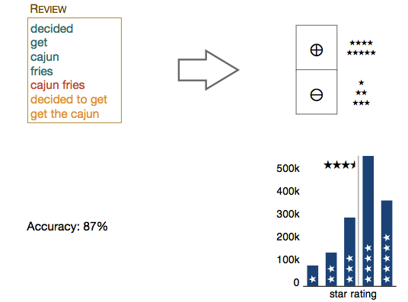
Polarity prediction

Slide 15
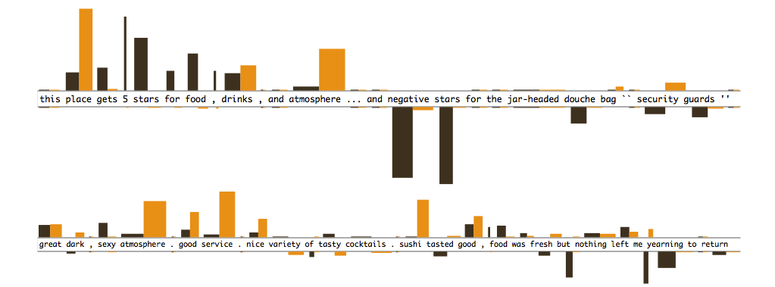
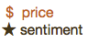
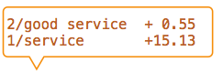
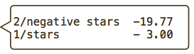

Slide 16
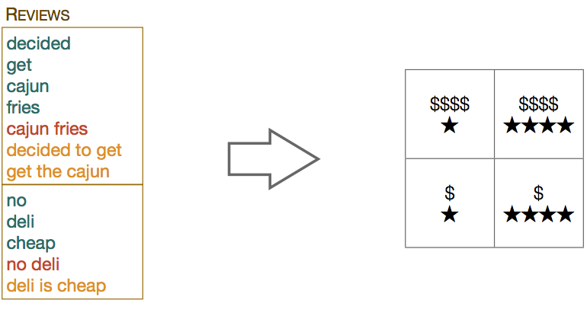
Joint price star prediction

Slide 17
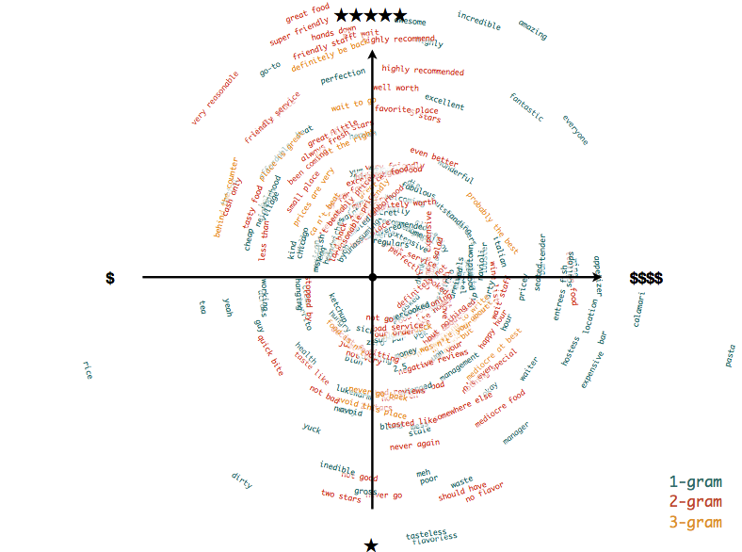

Slide 18
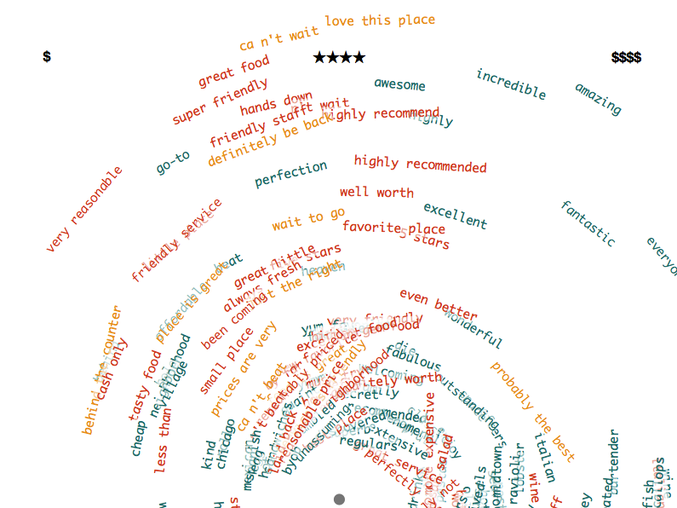

Slide 19
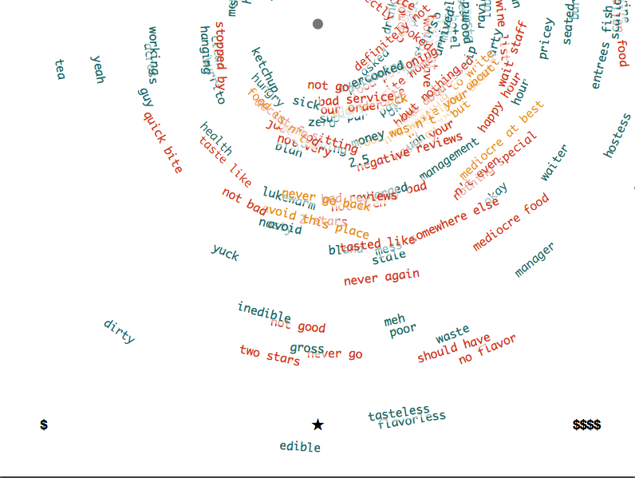

Slide 20
PAPER 2

Slide 21
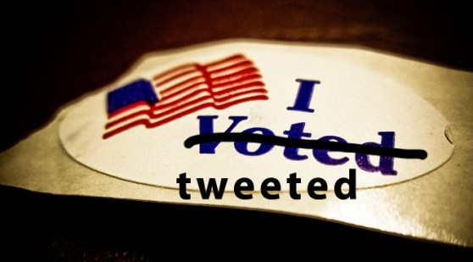
From Tweets to Polls: Linking Text Sentiment to Public Opinion Time Series B O’Connor, R Balasubramanyan, B.R Routledge, N.A Smith

Slide 22
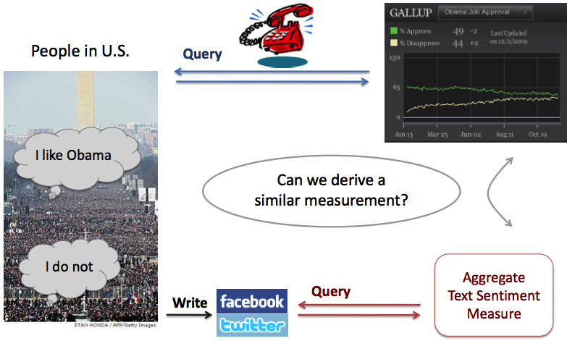
Measuring public opinion through social media?

Slide 23
Text Data: Twitter
Twitter is large, public
Sources
Archiving twitter Streaming API
Scrape of earlier messages via API
Sizes
0.7 billion messages, Jan 2008 – Oct 2009
1.5 billion messages, Jan 2008 _May 2010
user population are changing
Message Language
Identify user location
The Republican’s are less likely to used social media for political purposes
age
Misleading information

Slide 24
Poll Data
Consumer confidence
Index of Consumer Sentiment (ICS)
Gallup Daily
2008 Presidential Elections
Pollster.com
2009 Presidential Job Approval
Gallup Daily

Slide 25
Text Analysis
location
lying
Message retrieval
Identify messages relating to the topic
consumer confidence: job, jobs, economy
Presidential approval: obama
Election: obama, mccain
Opinion estimation
Positive opinion
Negative opinion
news
informal language
Can vote
age
Weight
Weak word = strong word

Slide 26
Sentiment analysis: word counting
Within topical messages
Count messages containing these positive and negative words
lexicon : 1200-1600 words marked as + or –
This list is not well suited for social media English
“sucks”, “ : ) ”, “ : ( “

Slide 27
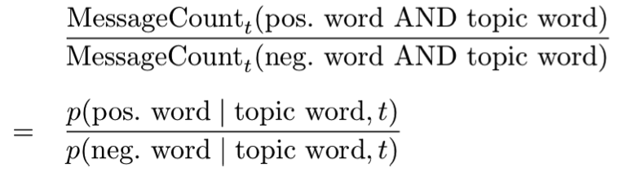
Sentiment ratio over Messages
For one day t and topic word, compute score

Slide 28
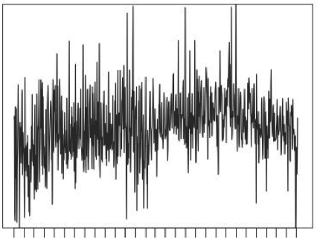
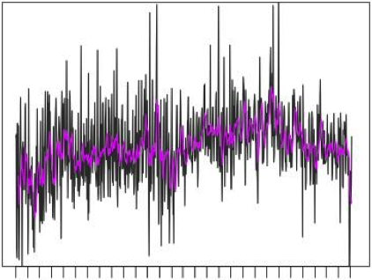

Sentiment Ratio Moving Average
High day-to-day volatility.
Average last k days
Keyword “jobs”
K = 1, 7, 30
Gallup

Slide 29
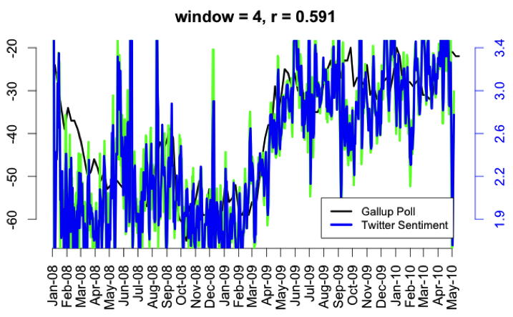
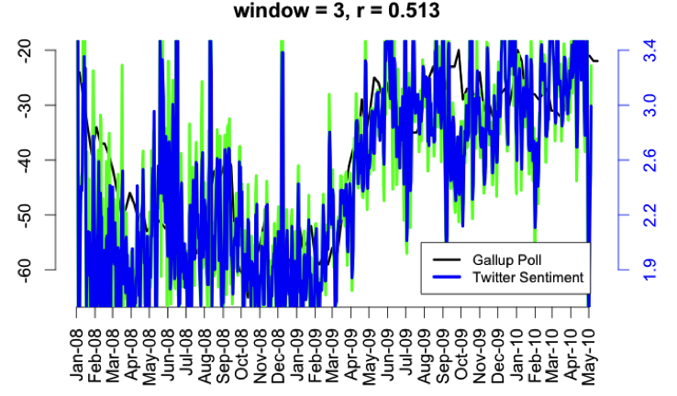
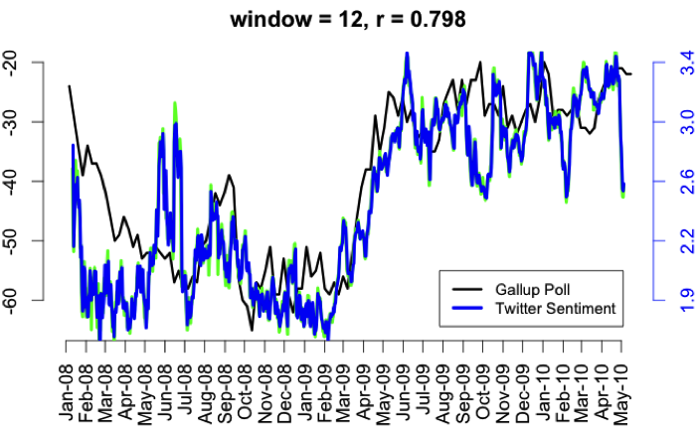
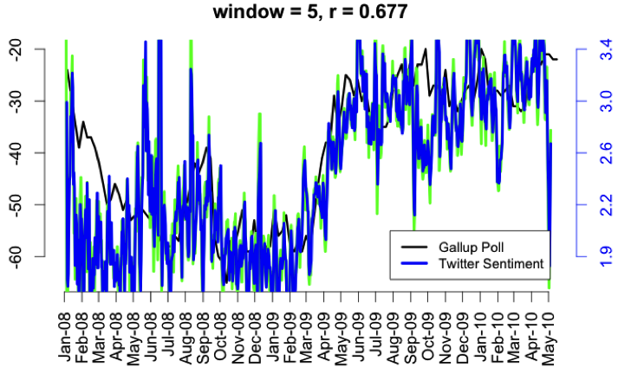
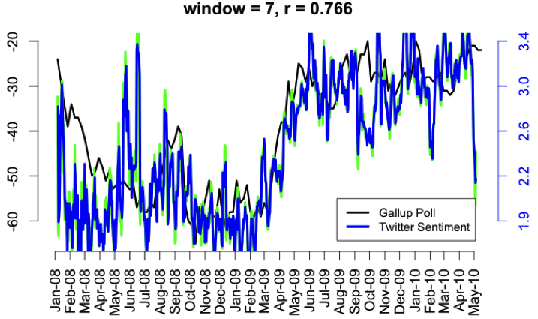

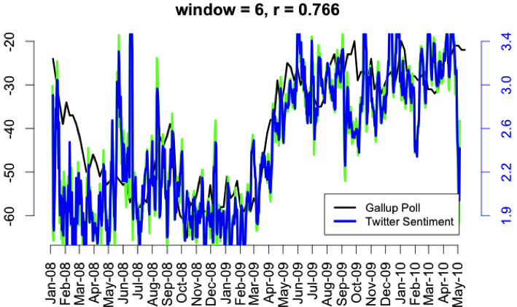
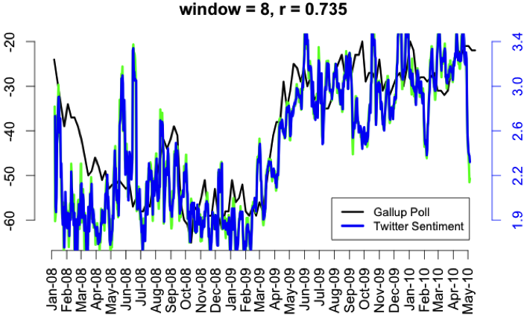
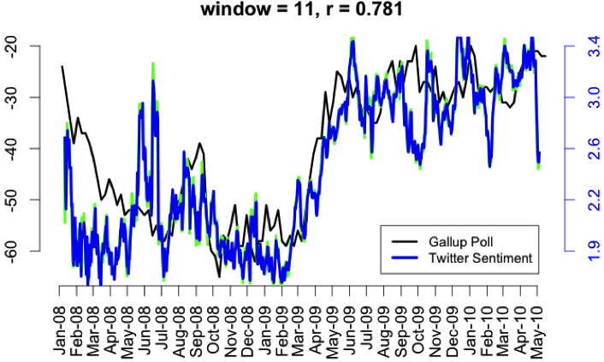

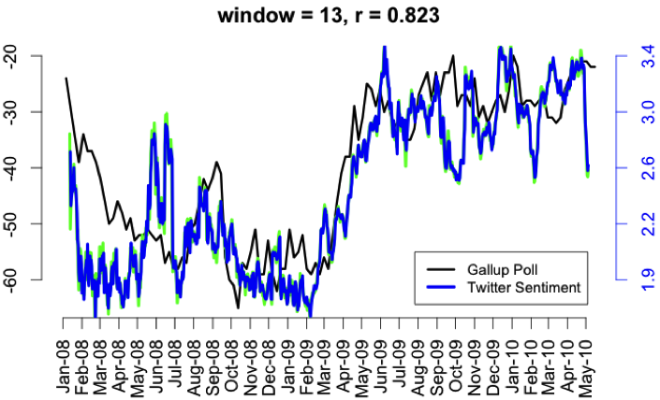
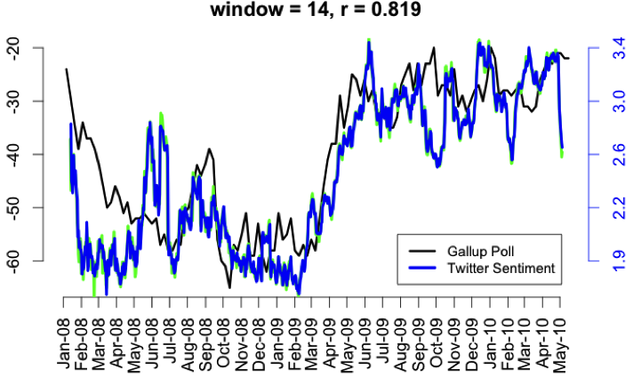
Correlation Analysis:
Smoothed comparisons ,”jobs” sentiment
Stock market go’s up
Stock market
Go’s down

Slide 30
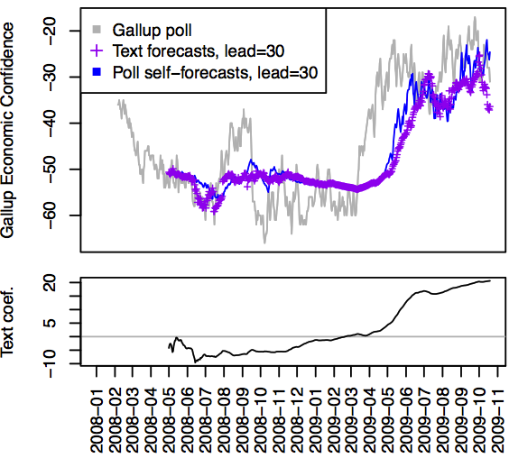
Predicting polls
Text sentiment is a poor predictor of consumer confidence
L+K days are necessary to cover start of the text sentiment window

Slide 31
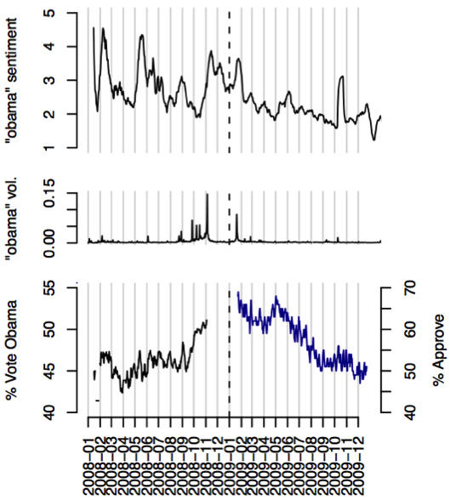
Presidential elections and job approval
Sentiment ratio has negative correlate to the election r = -8%
Looks easy : simple decline
r=72.5% k= 15

Slide 32
PAPER 3

Slide 33
"I Wanted to Predict Elections with Twitter and all I got was this Lousy Paper" -- A Balanced Survey on Election Prediction using Twitter Data D Gayo-Avello

Slide 34
Flaws in using Twitter Data for Election Prediction
It’s not prediction at all
Chance is not valid baseline
There is not a commonly accepted way of “counting votes” in Twitter
There is not a commonly accepted way of interpreting reality
Sentiment analysis are only slightly better than random classifiers
All the tweets are assumed to be trustworthy
Demographics are neglected
Self-selection bias is simply ignored

Slide 35
Recommendations for using Twitter Data for Election Prediction
There are elections virtually all the time, thus, if you are claiming you have a prediction method you should predict an election in the future!
Check the degree of influence incumbency plays in the elections you are trying to predict. Your baseline should not be chance but predicting the incumbent will win. Apply that baseline to prior elections
Small amount of data available
All elections are not important like presidential election

Slide 36
Recommendations for using Twitter Data for Election Prediction
Clearly define which is a “vote” and provide sound and compelling arguments supporting your definition.
Clearly define the golden truth you are using. use the “real thing”
Why are you using some of the users? or not?
How filter your data?

Slide 37
Recommendations for using Twitter Data for Election Prediction
Sentiment analysis is a core task.
We should first work on sentiment analysis in politics before trying to predict elections.
Credibility should be a major concern.
Remove spammers

Slide 38
Recommendations for using Twitter Data for Election Prediction
adjust your prediction:
the participation of the different groups in the prior election’s you are trying to predict
the belonging of users to each of those groups.
The silent majority is a huge problem.

Slide 39
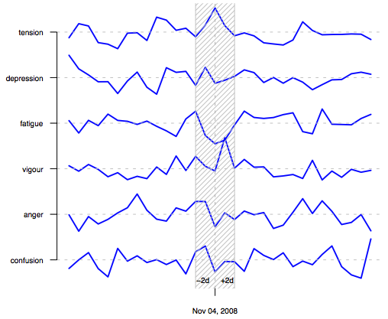
Relevant prior Art
Bollen : “we assess the validity of our sentiment analysis by examining the effects of particular events, namely the U.S. Presidential election of November 4, 2008, and the Thanksgiving holiday in the U.S., on our time series. “
application of mood (not sentiment)
Modeling Public Mood and Emotion: Twitter Sentiment and Socio- Economic Phenomena Bollen, J., Pepe, A., and Mao, H. 2009.
Definition of data and mood assessment
Data cleaning, parsing ad normalization
Time series production: aggregation of POMS mood scores over time
This paper dose not describe any predictive method
Used US 2008 Obama Election , no conclusions are inferred regarding the predictability of election

Slide 40
Relevant prior Art
Paper 2(From Tweets to Polls )
No correlation was found between electoral polls and Twitter sentiment data

Slide 41

Relevant prior Art
Predicting Elections with Twitter: What 140 Characters Reveal about Political Sentiment Tumasjan, A., Sprenger, T.O., Sandner, P.G., and Welpe, I.M. 2010.
Used LIWC for analysis of the tweets related to different parties running (German 2009 election)
Only count of tweets mentioning a party or candidate accurately predicted the election results
they claim that the MAE of the “prediction” based on Twitter data was rather close to that of actual polls.

Slide 42

Relevant prior Art
Why the Pirate Party Won the German Election of 2009 or The Trouble With Predictions: A Response to previous slide Jungherr, A., Jürgens, P., and Schoen, H. 2011.
method by Tumasjan et al. was based on arbitrary choices
not taking into account all the parties running for the elections but just those represented in congress
results varied depending on the time window used to compute them.

Slide 43

Relevant prior Art
Where There is a Sea There are Pirates: AResponse to previous slide Tumasjan, A., Sprenger, T.O., Sandner, P.G., and Welpe, I.M. 2011.
Twitter data is not to replace polls but to complement them

Slide 44

Relevant prior Art
Understanding the Demographics of Twitter Users Mislove, A., Lehmann, S., Ahn, Y.Y., Onnela, J.P., and Rosenquist, J.N. 2011.
The methods applied are simple but quite compelling
All of the data was inferred from the users profiles
This is consistent with some of the findings of Gayo-Avello [8]

Slide 45


